Slide 1
Customer Portal

Slide 2
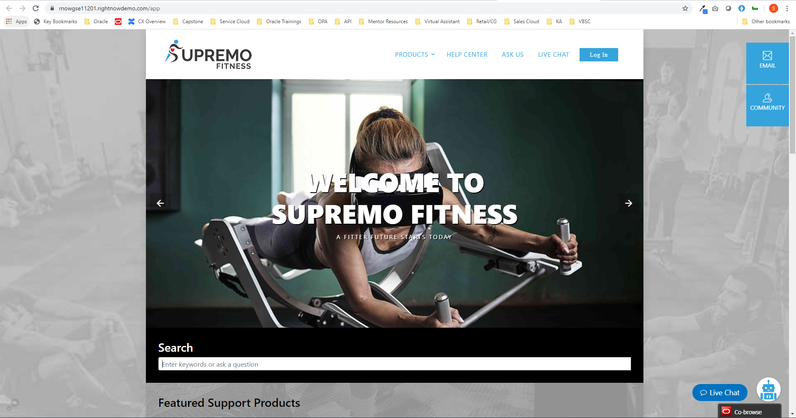
This is Customer Portal—think of it like commerce self service pages. This is where customers/internal employees would go to find answers, connect with a live agent, etc.

Slide 3
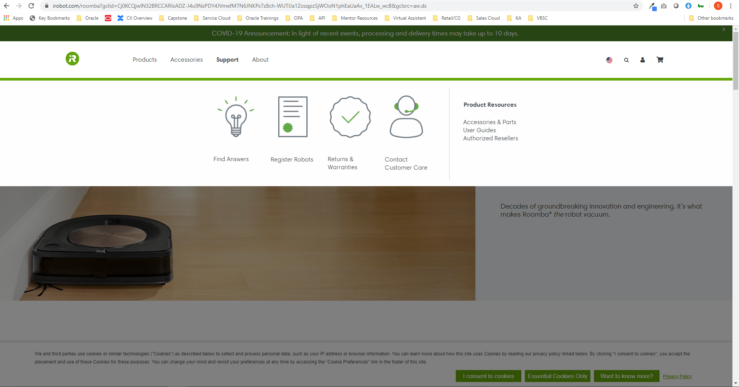
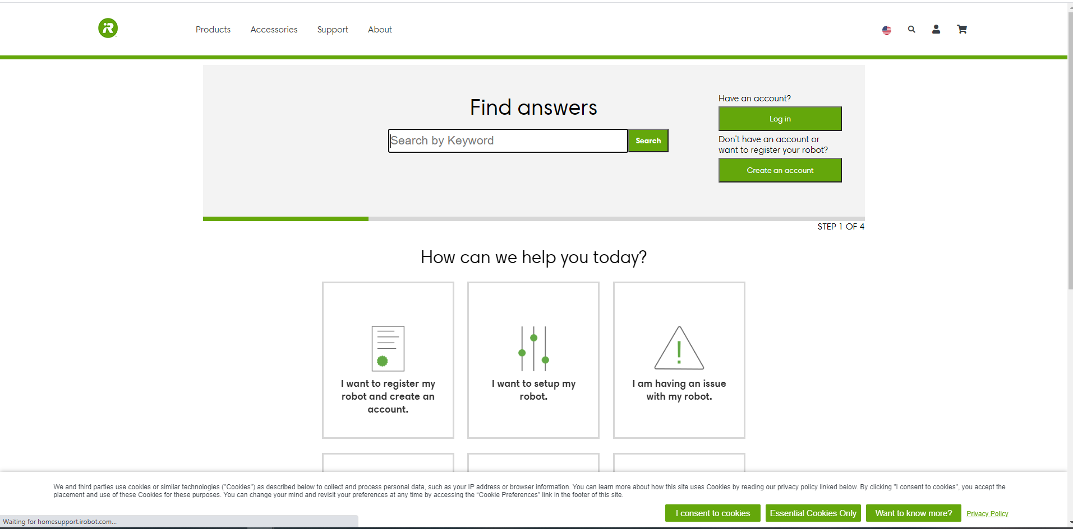
Customer example of how this can be seamlessly integrated and embedded with website
How you display answers/service cloud functionality can be extended
Example of matching the look and feel of brands

Slide 4
Console

Slide 5
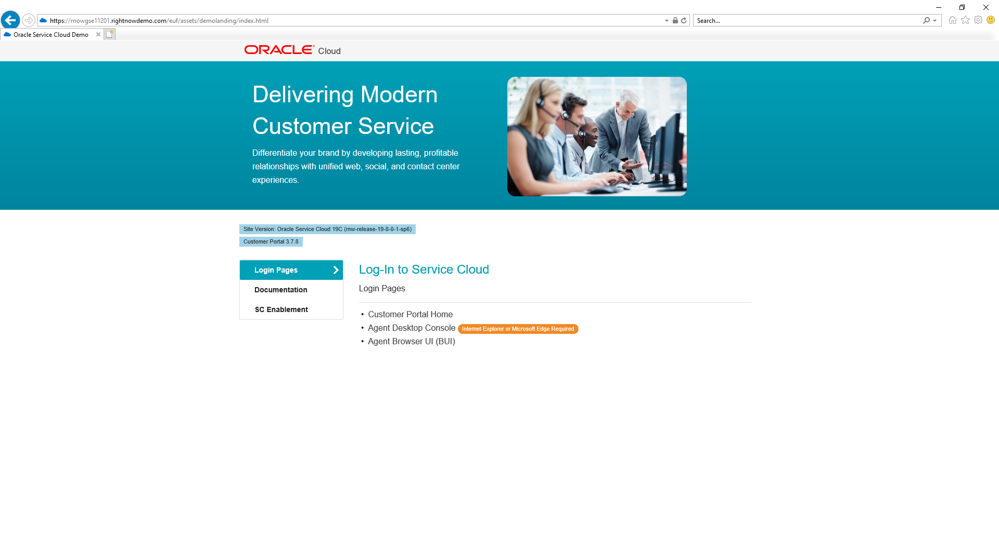
Open demo landing page in Internet Explorer or edge
Click on Agent Desktop Console

Slide 6
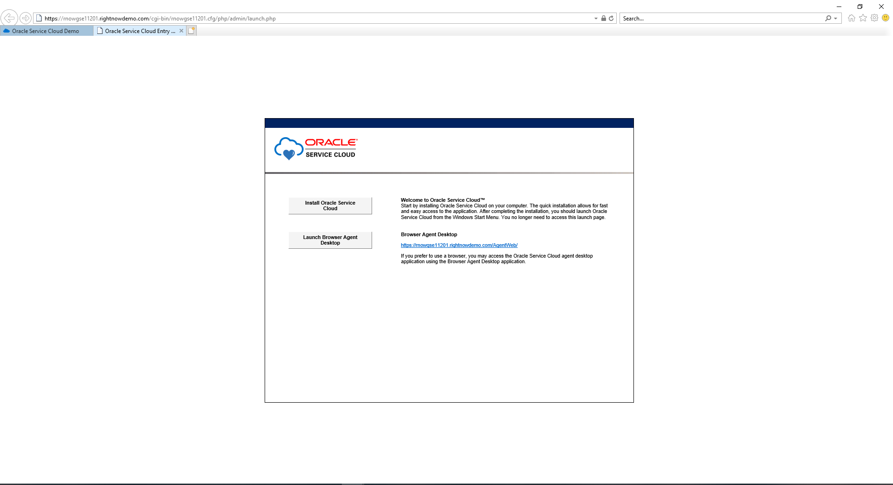
Install Oracle Service Cloud
(Only needs to be done the first time and if you need to make configuration changes. For example, just want to respond to a chat can open the browser version and never have to download.
Once downloaded search in computer for environment name: rnowgseXXXXX

Slide 7
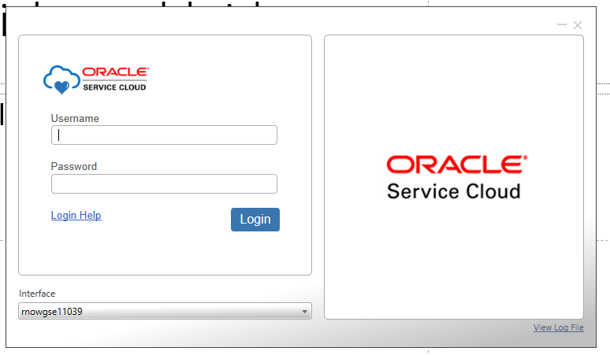
Log in using Admin1 or Admin 2
Environment password
The first time logging in will probably take a few mins

Slide 8
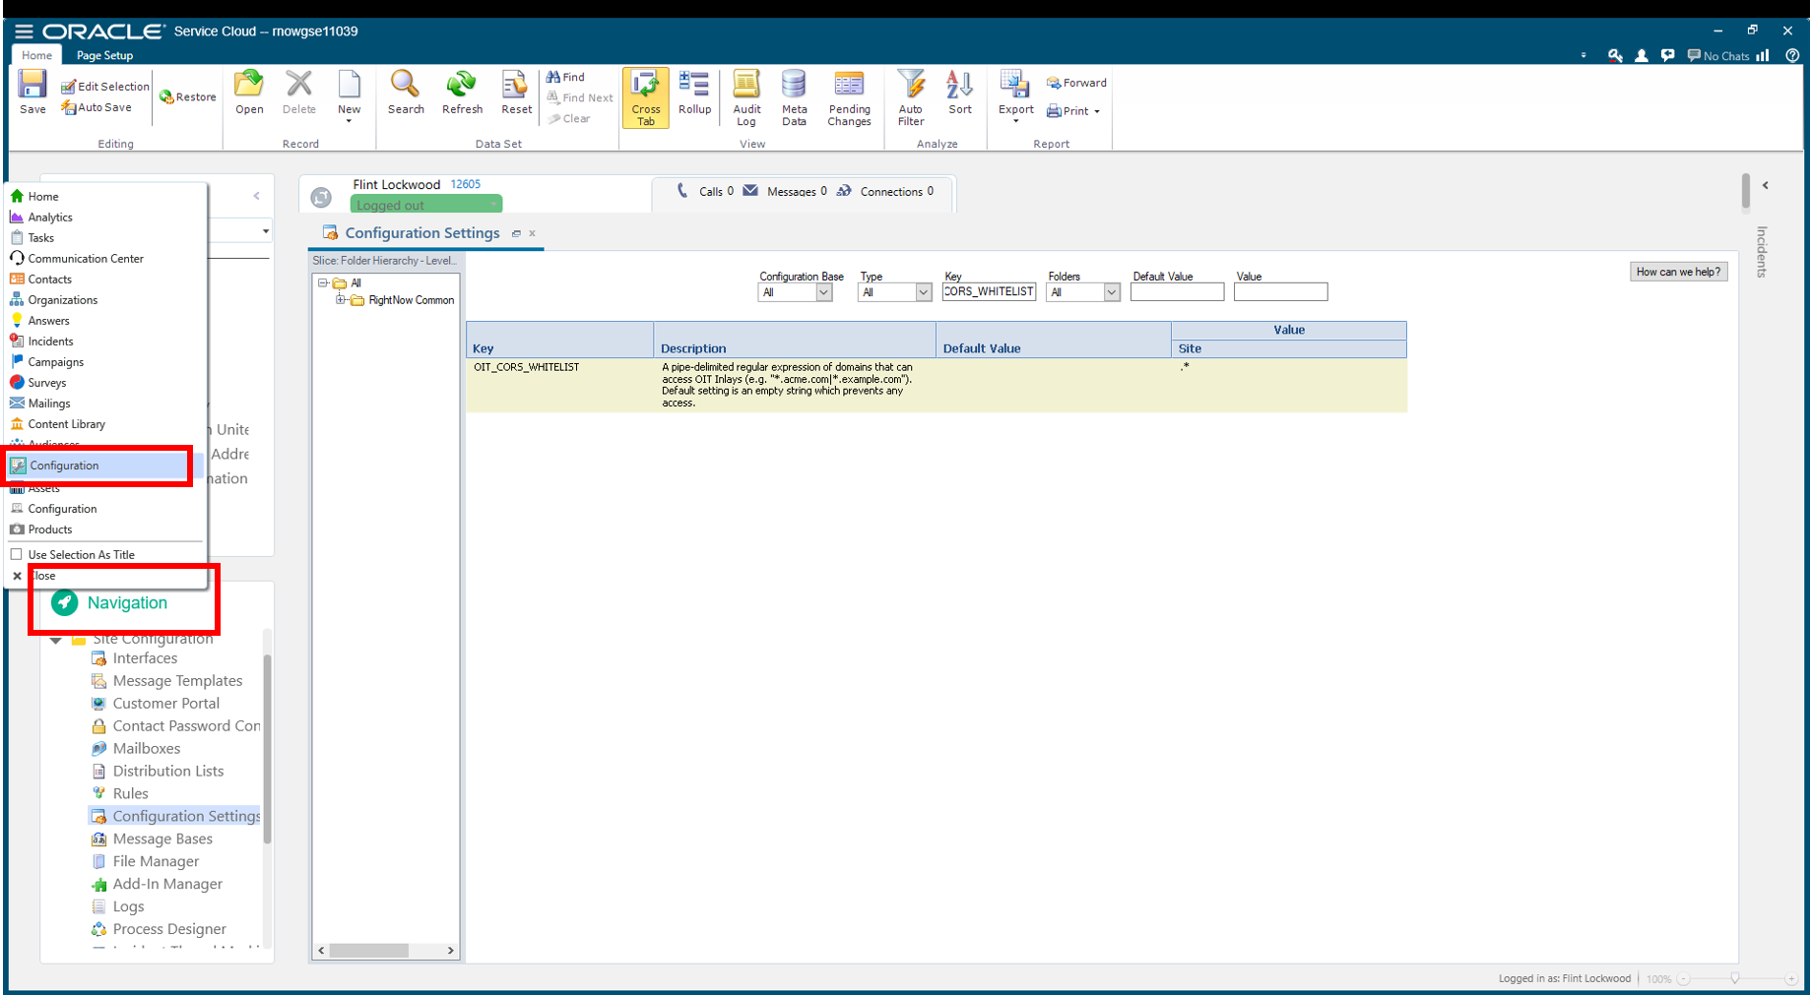

Slide 9
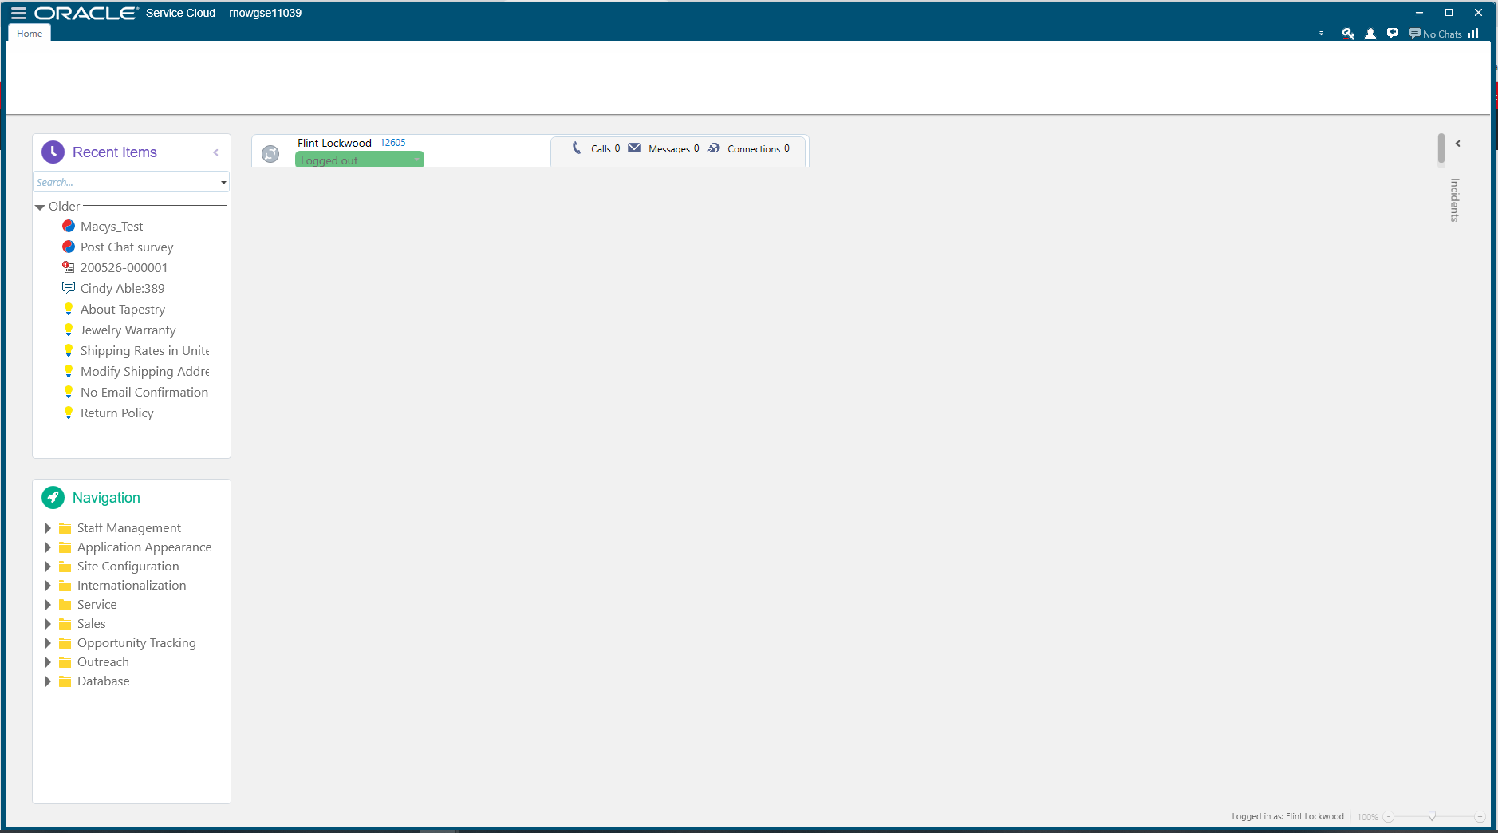
This is the Agent/Admin Console
Most organizations are currently making the migration from this to the browser experience (modern UI)
However, most configuration changes most happen in here so Admins will still have this look and feel

Slide 10
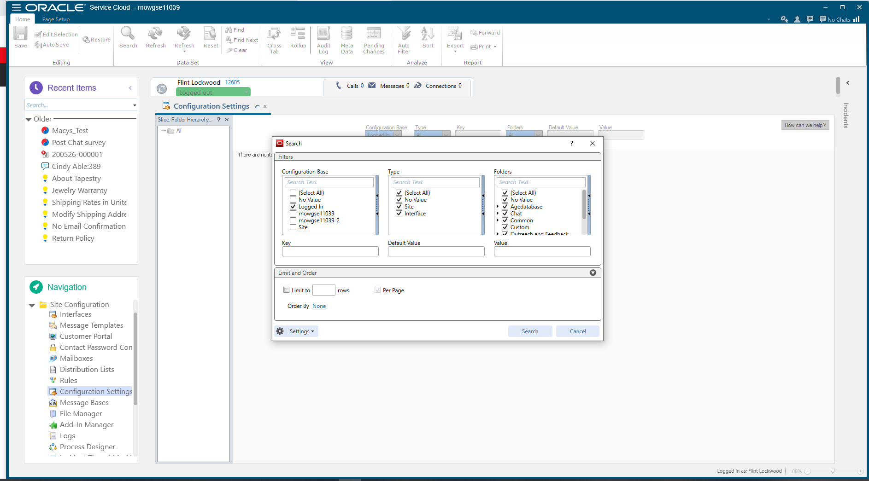
Navigation -> Site Configuration -> Configuration Settings

Slide 11
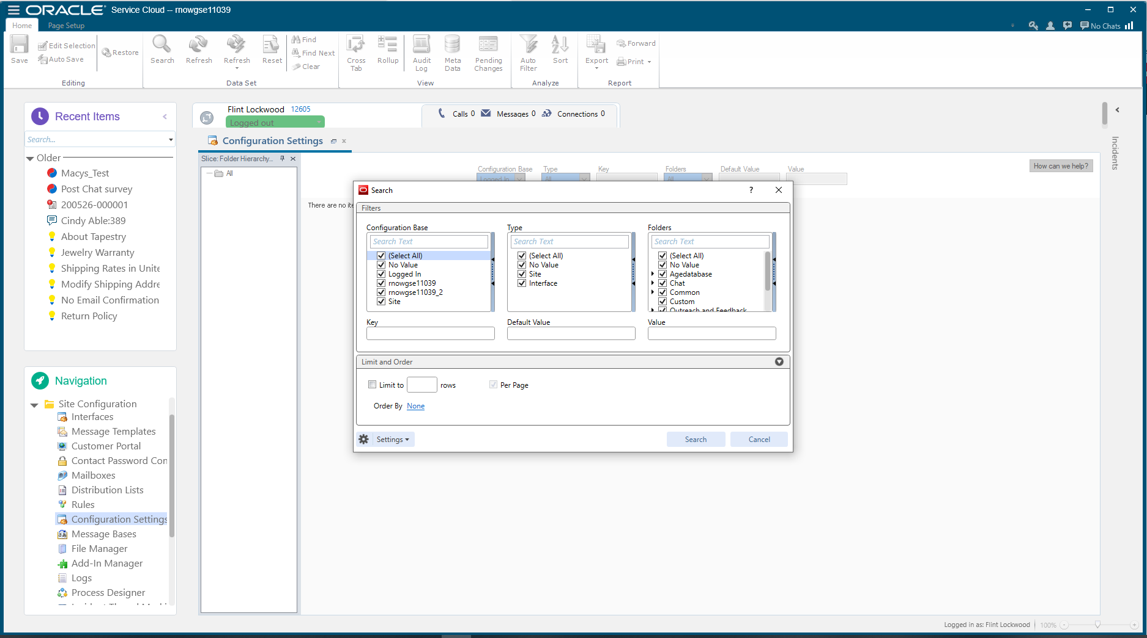
Select all and search

Slide 12
Select all and search

Slide 13
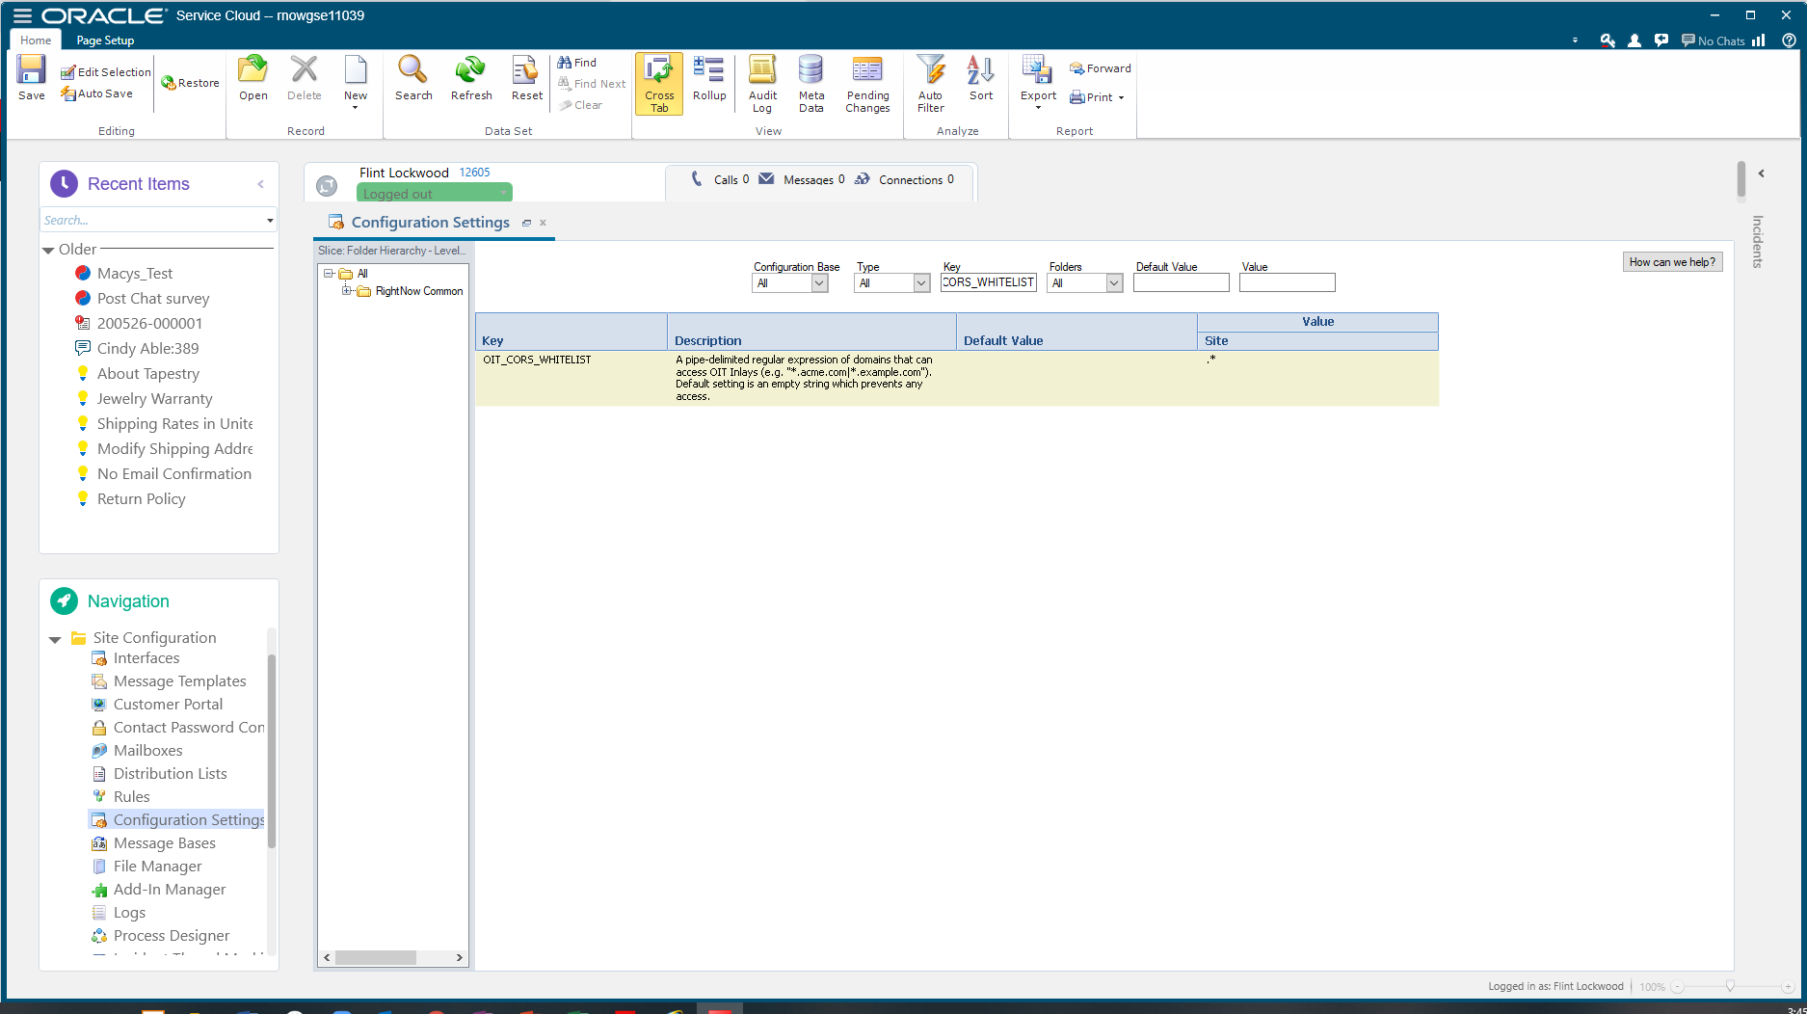
Search OIT_CORS_WHITELIST in the key
Click on the value under site to edit
Add .*
Save
Blank means no external site will be allowed to use the inlays
.* means every site
.* is not recommended for actual customer implementations, just demos/ testing

Slide 14
Agent Browser

Slide 15
Open Agent Browser UI (BUI)

Slide 16
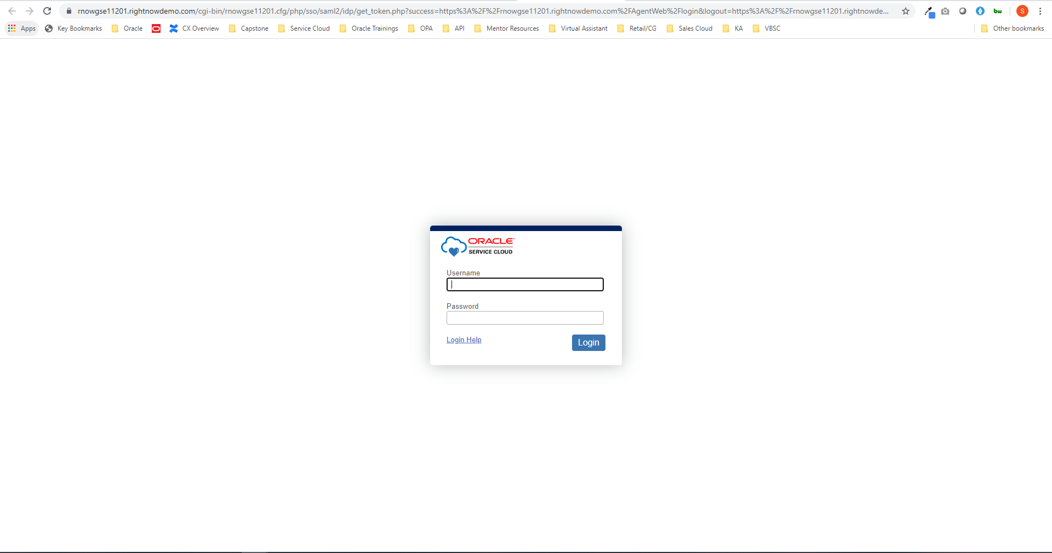
Log in with Admin1, Admin 2, Agent1, Agent 2
Environment Password

Slide 17
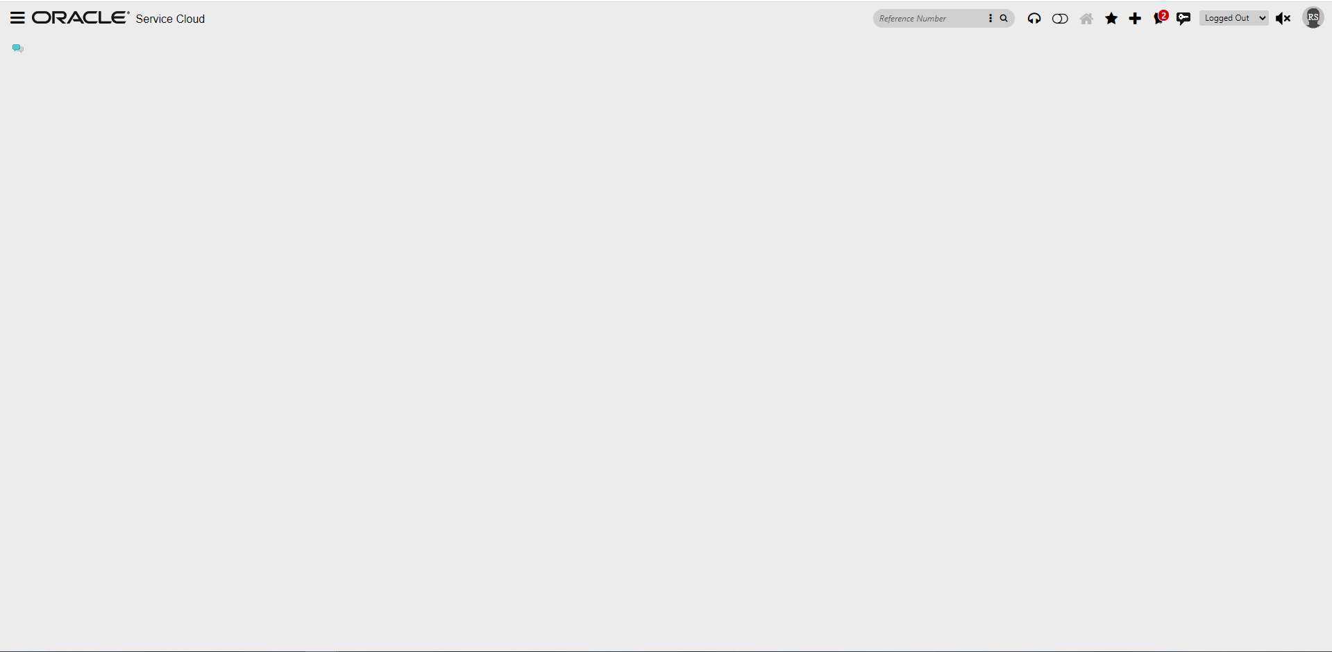
This is navigation bar where you can view Contacts, Organizations, Answers, and Incidents
Service Cloud is profile based so agents will only have access/see what they need to complete their job

Slide 18
Hit Lock
Set to Unrestricted to be able to receive chats
Able to set it up so can see multiple chats at once

